Slide 1
Practice Activity Number 1
File created on: 3/15/2021 8:03:05 AM

Slide 2
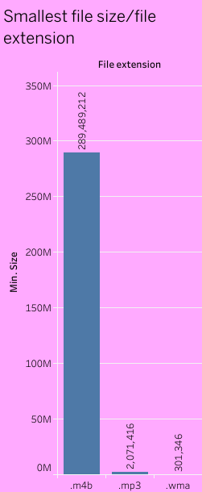

Slide 3
